Slide 1

Integer Programming and Combinatorial Optimization
24th International Conference Madison, WI, USA
June 21–23, 2023
IPCO 2023

Slide 2


IPCO 2023
Best Paper Award
Daniel Dadush, Friedrich Eisenbrand, Thomas Rothvoss
For the paper entitled
“From approximate to exact integer programming”
June 23, 2023

Slide 3
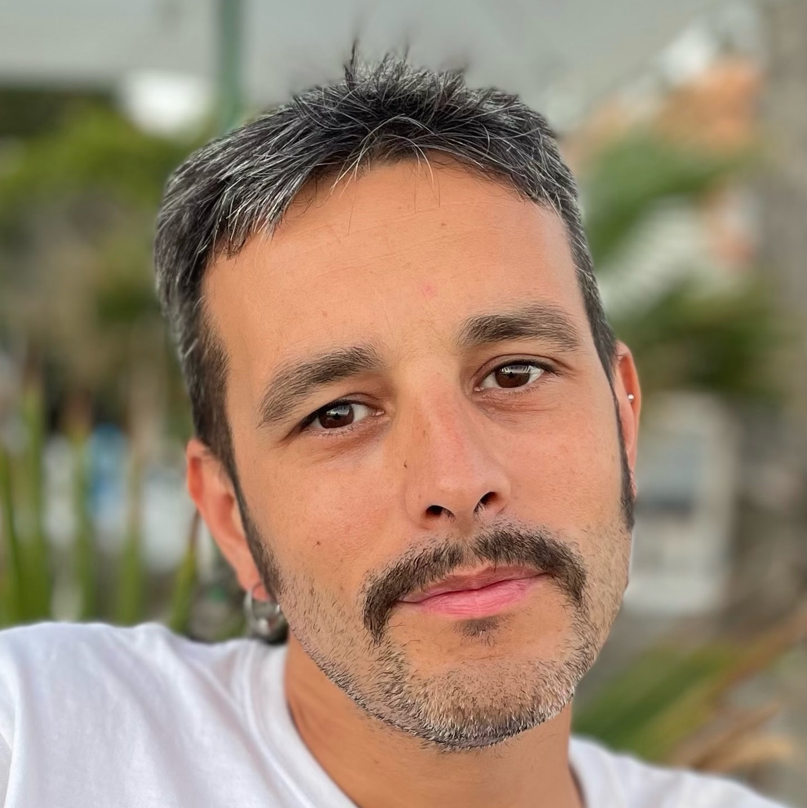

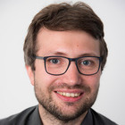
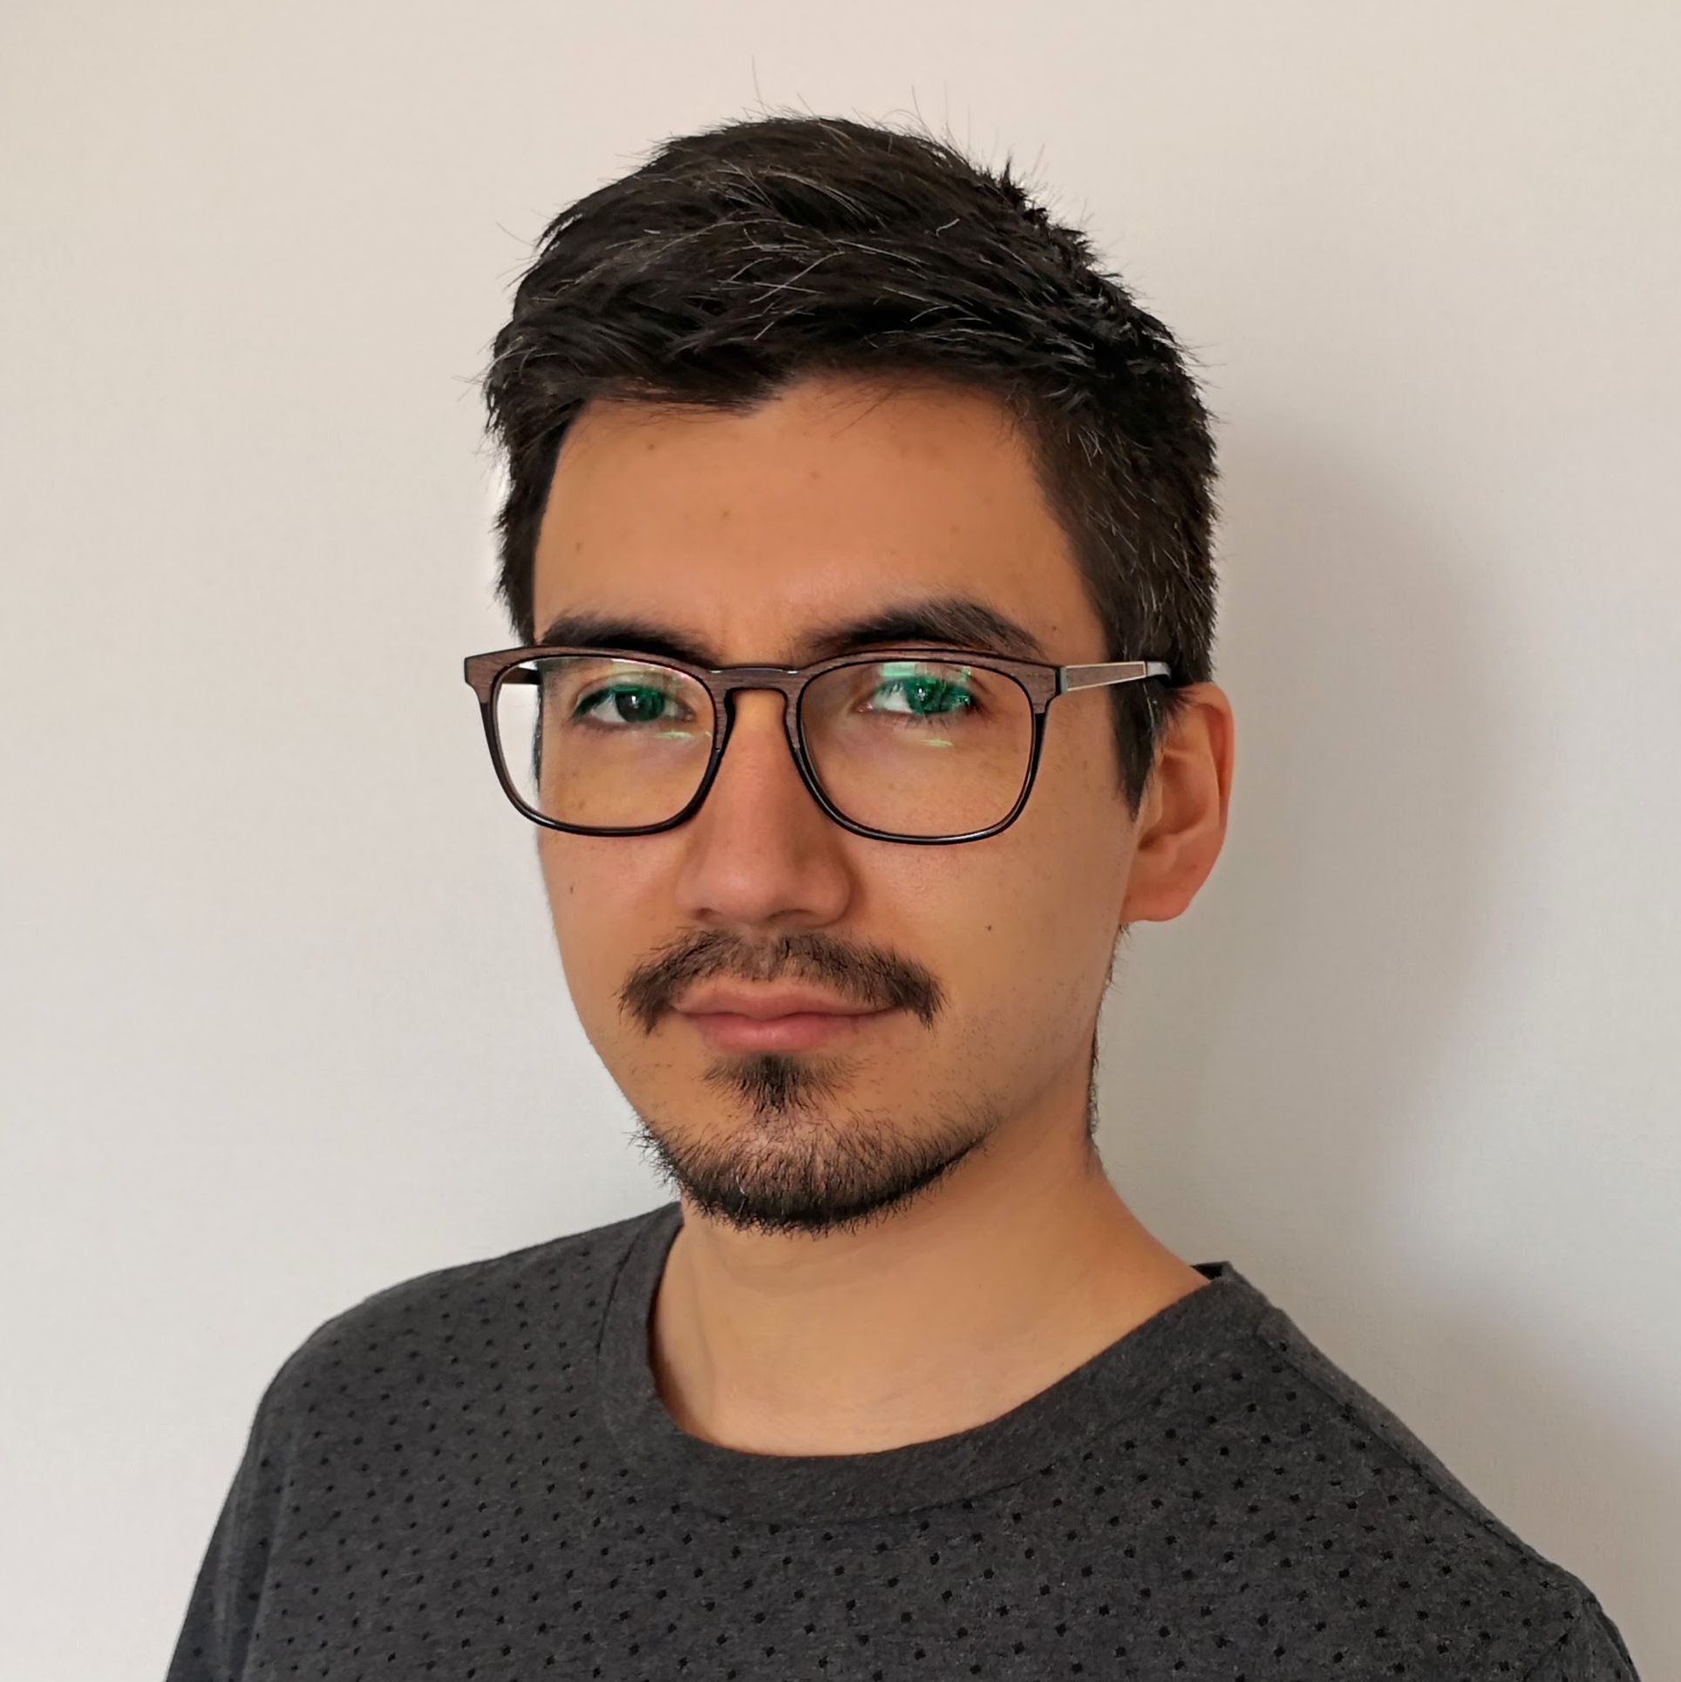
POSTER AWARD COMMITTEE
Victor Blanco
(Granada)
Jean Cardinal
(ULB)
Jannik Matuschke
(KU Leuven)
Gonzalo Muñoz
(O'Higgins)

Slide 4
IPCO 2023
Honorable Mention Poster Award
Maral Shahmizad
Joint work with Austin Buchanan
For the poster entitled
“Political Districting to Minimize County Splits”
June 23, 2023

Slide 5
IPCO 2023
Honorable Mention Poster Award
Anthony Karahalios
Joint work with Willem-Jan van Hoeve
For the poster entitled
“Column Elimination for Large-Scale Integer Programming”
June 23, 2023

Slide 6
IPCO 2023
Best Poster Award
Evangelia Gergatsouli
Joint work with Shuchi Chawla, Yifeng Teng, Christos Tzamos, and Ruimin Zhang
For the poster entitled
“Opening Pandora’s Box: the Correlated Case”
June 23, 2023

Slide 7
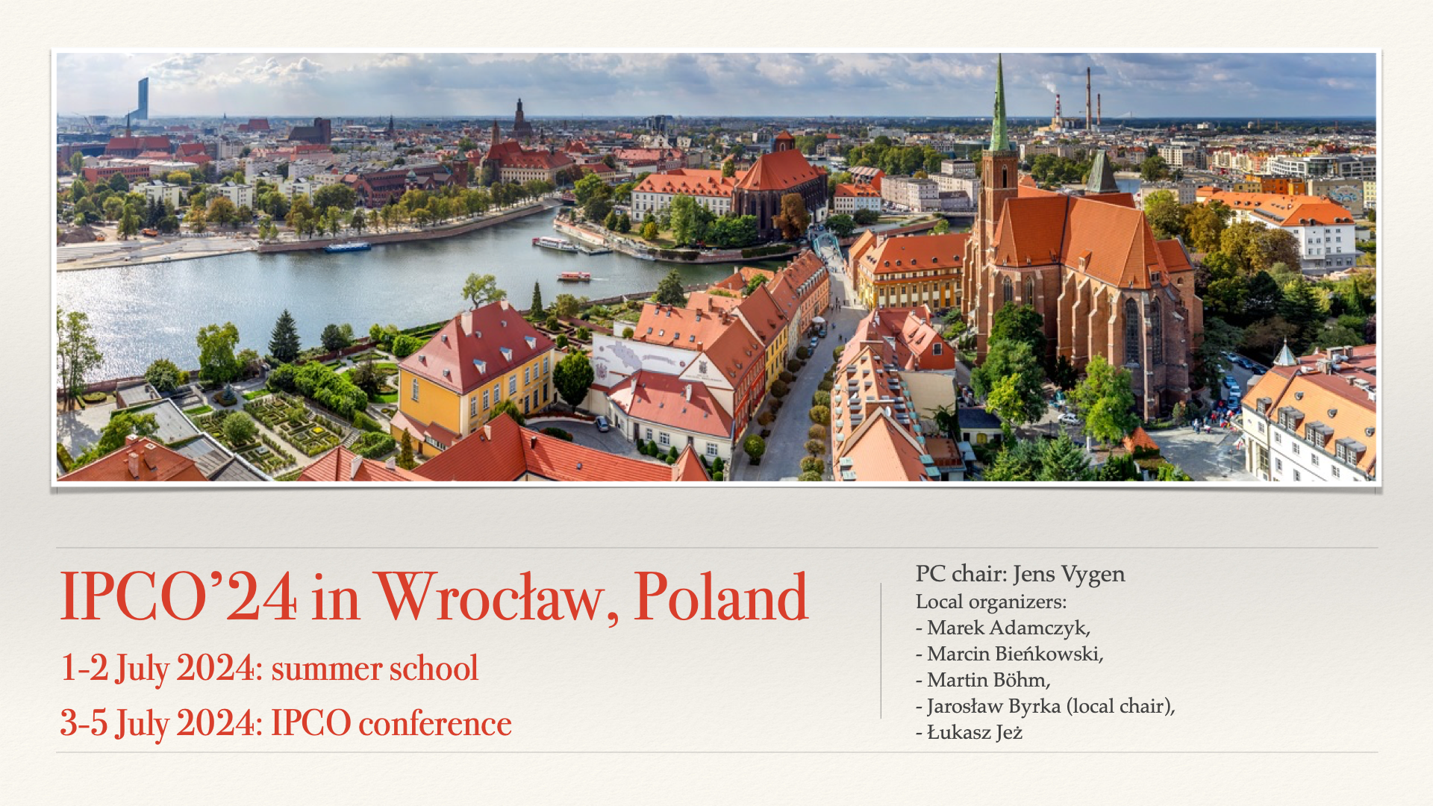

Slide 8
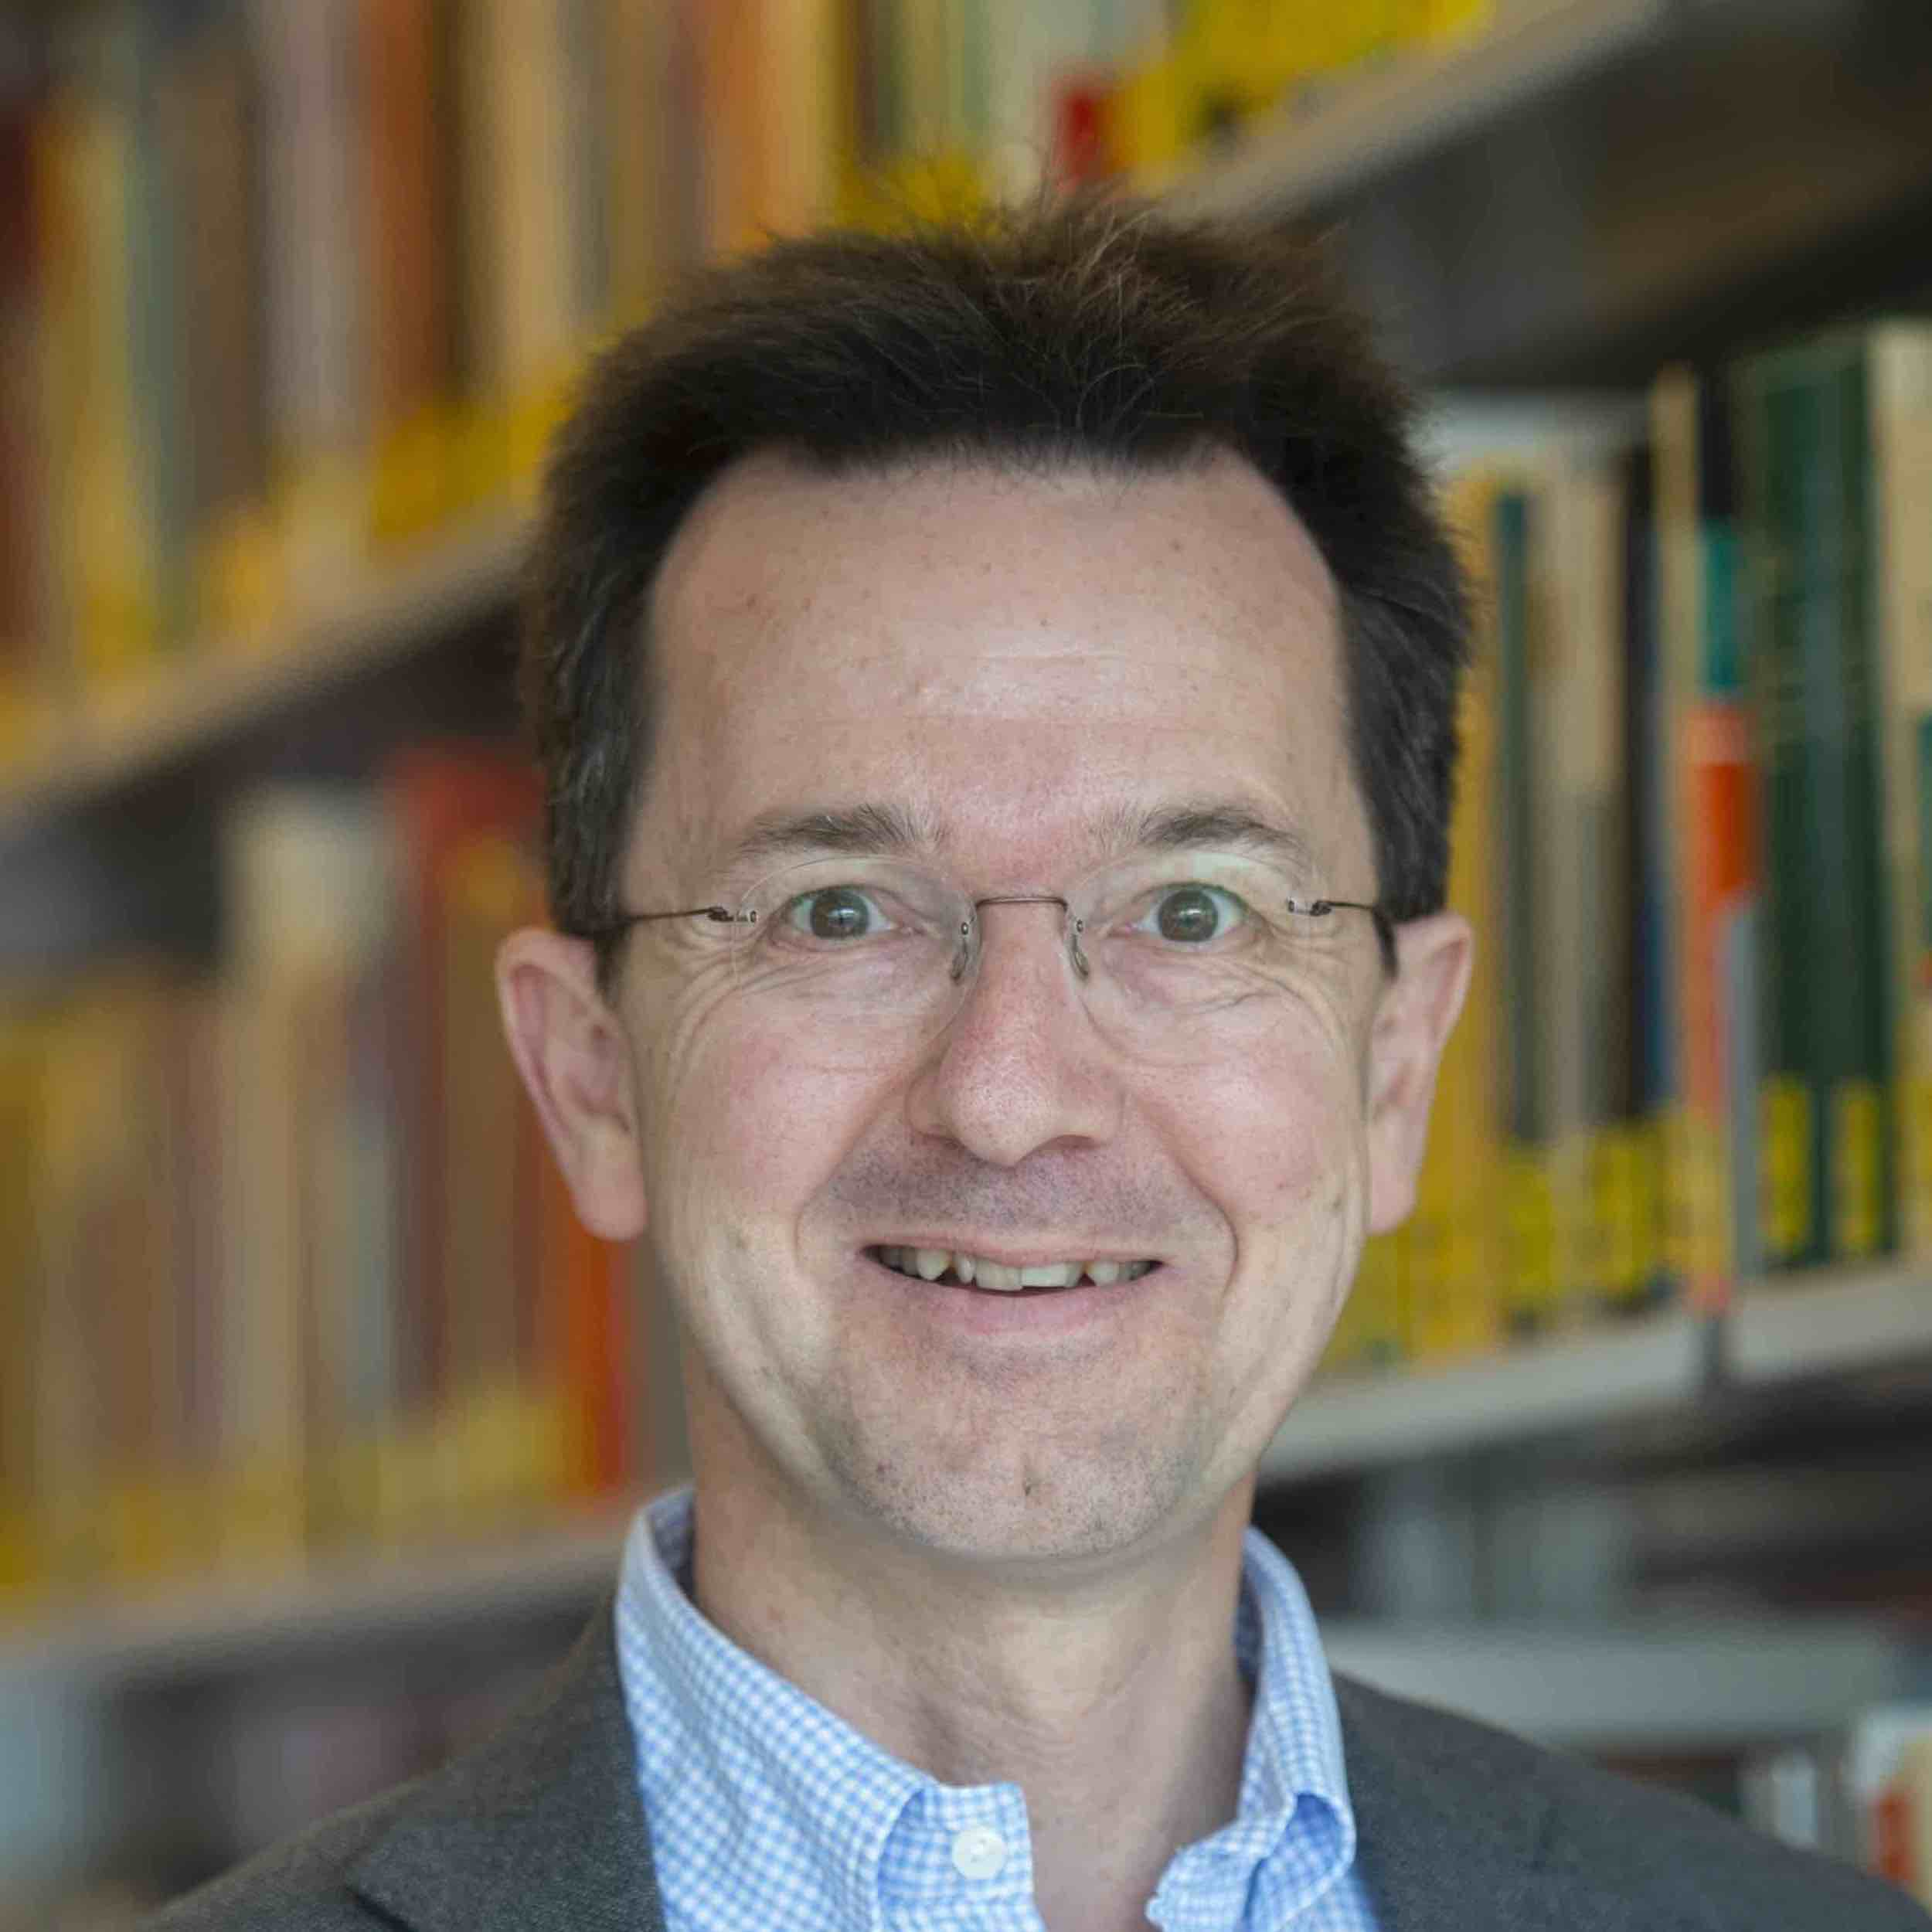
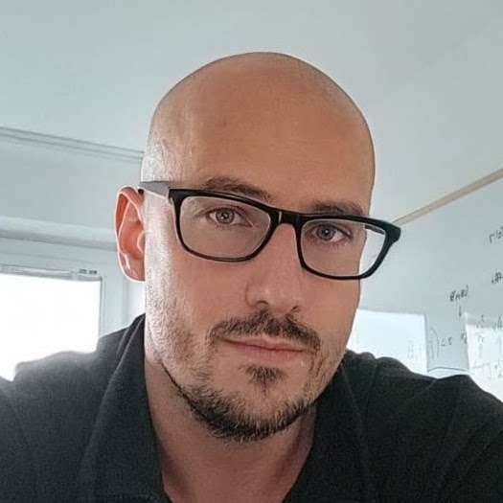
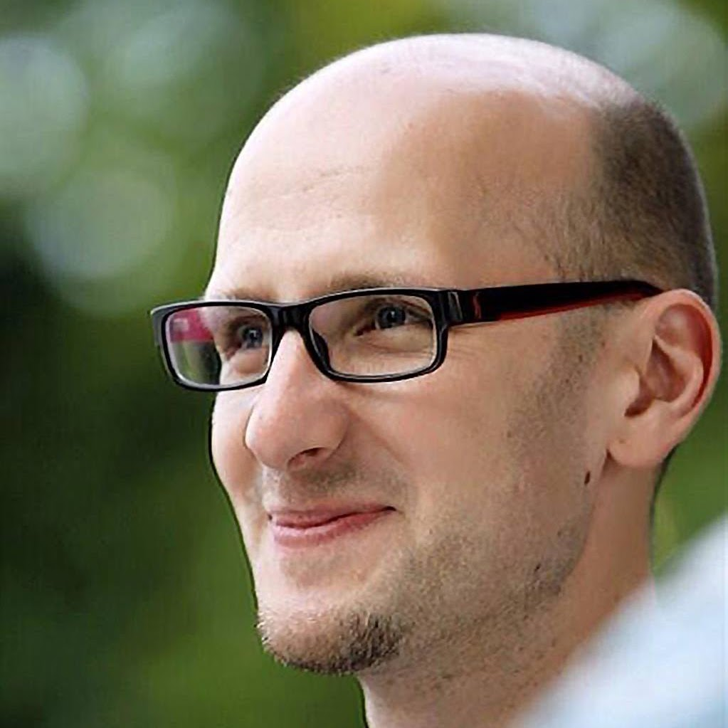
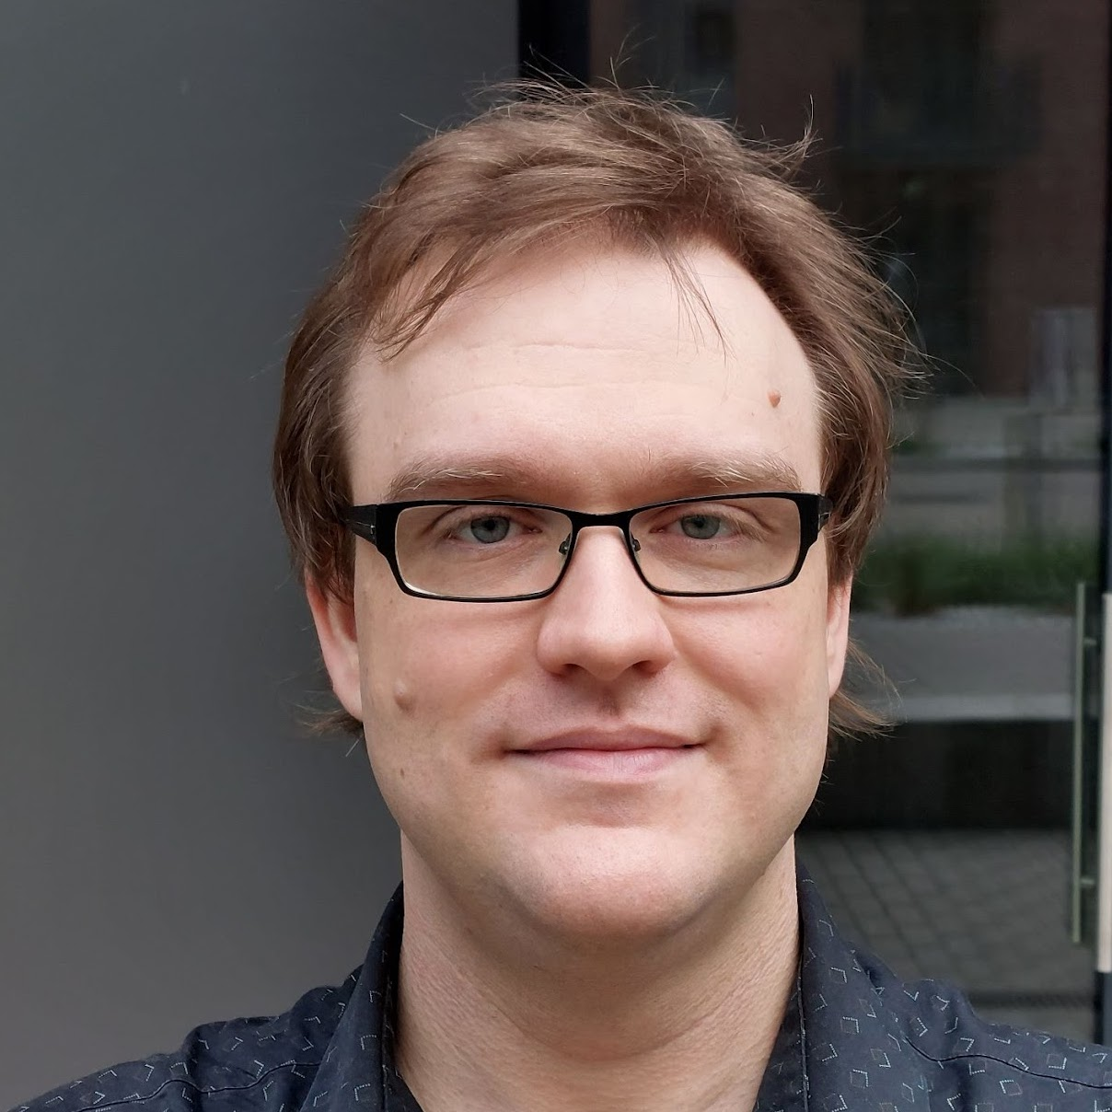
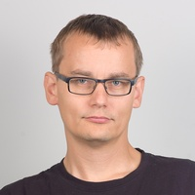
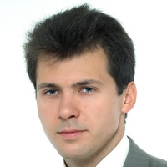
IPCO 2024
PC Chair: Jens Vygen
Local Committee
Marek Adamczyk
Marcin Bieńkowski
Martin Böhm
Jarosław Byrka (chair)
Łukasz Jeż

Slide 9









Our Sponsors

